Slide 1
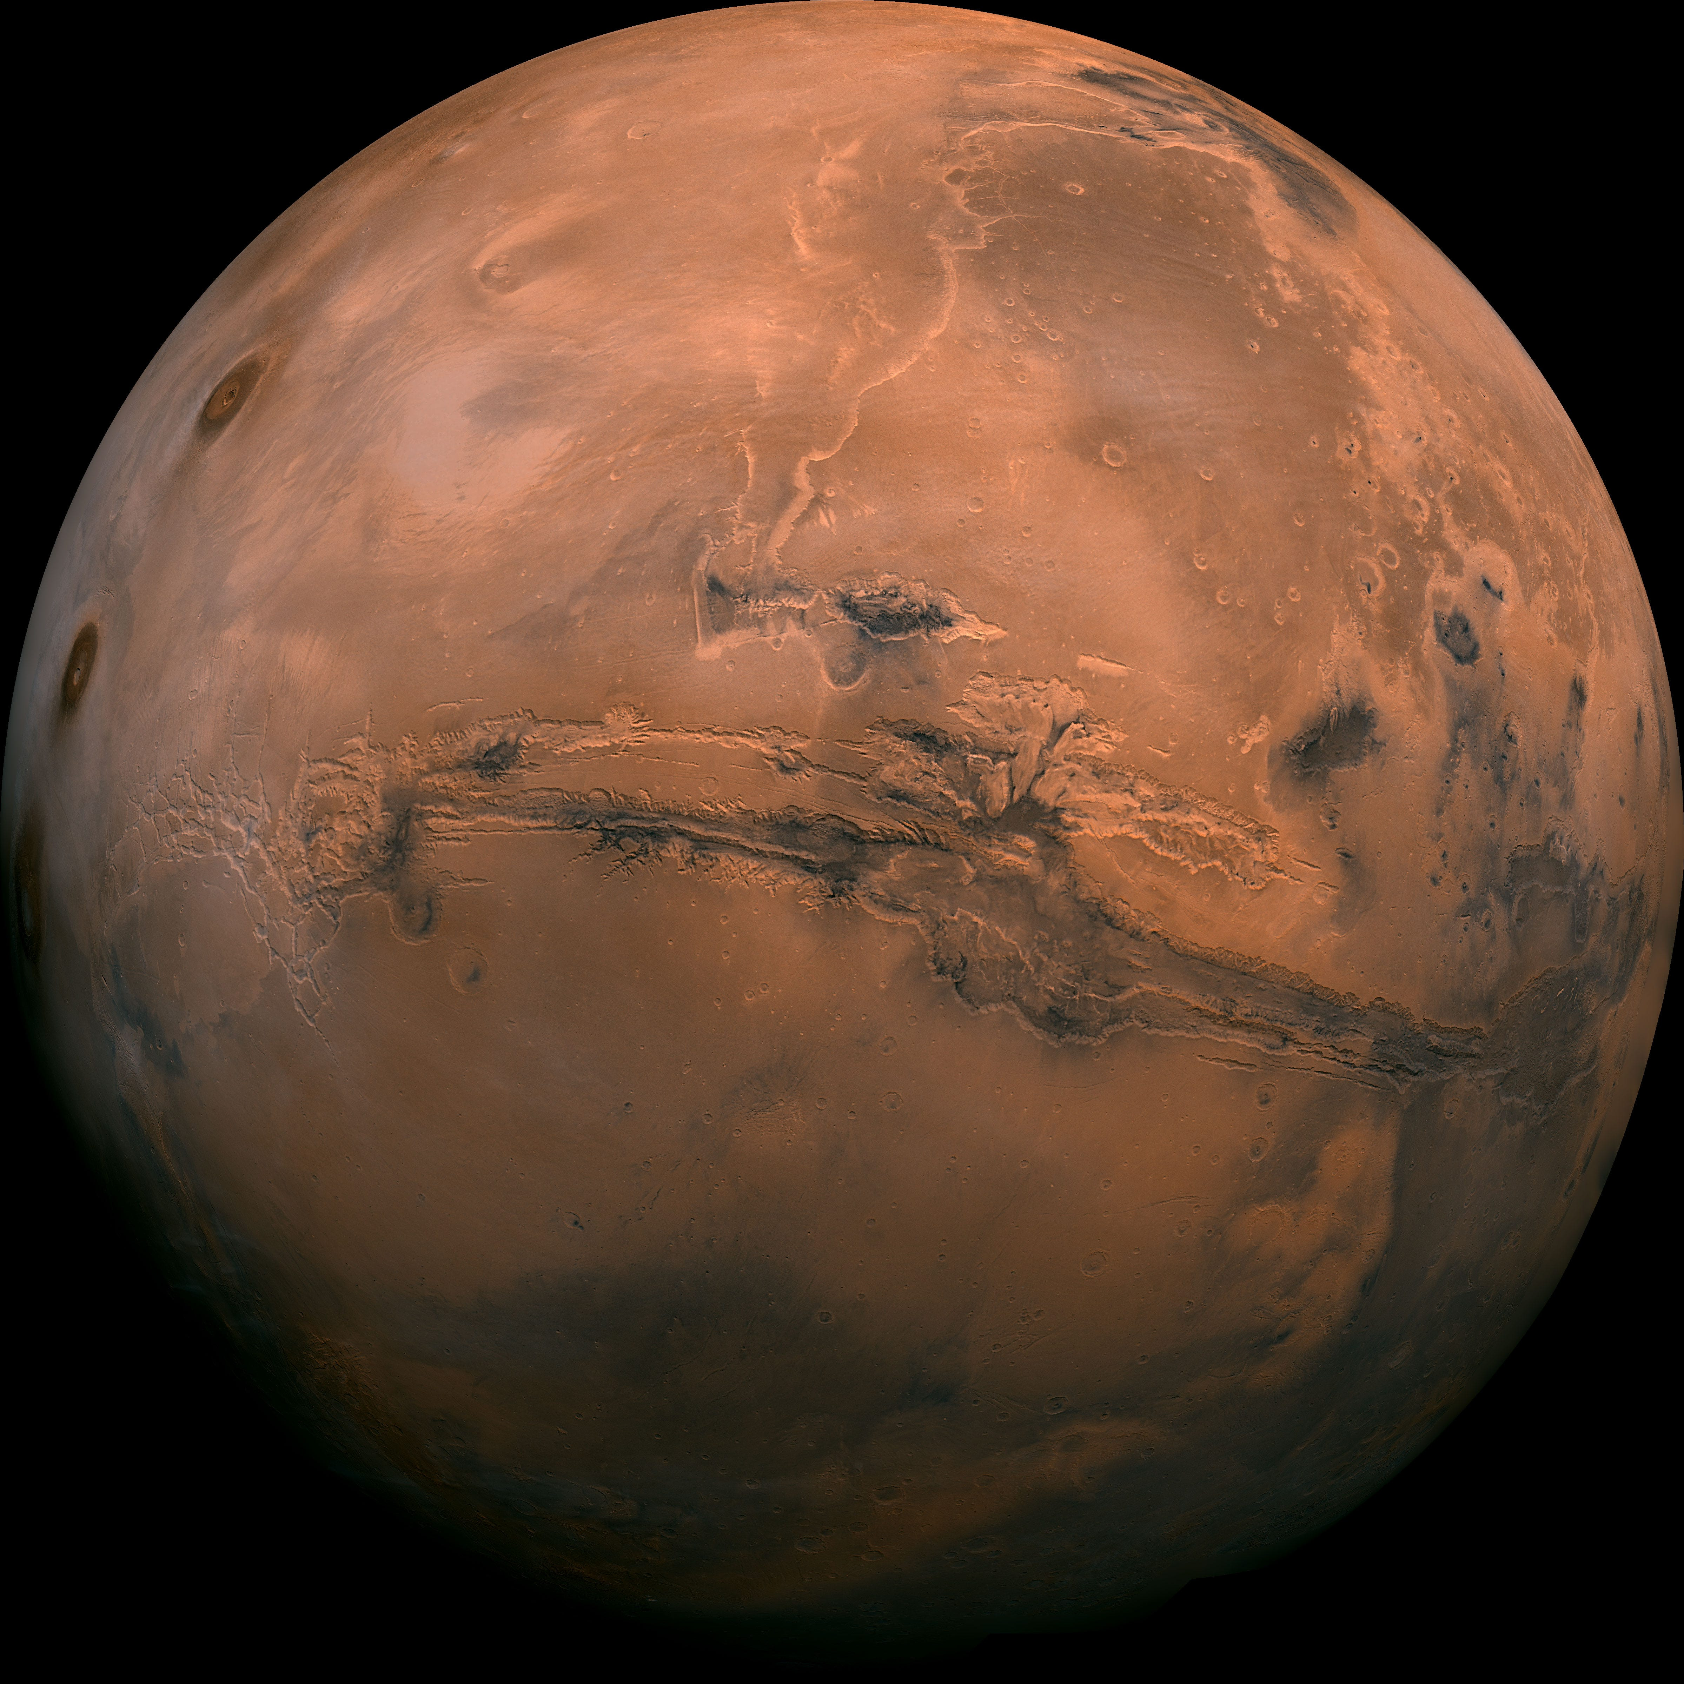
WORK-EXPERIENCE PROJECT
Design a
Mars Mission
Using mathematics, engineering and software to simulate a journey from Earth to Mars
Student presentation • Next.js simulator • Hohmann transfer
Design a Mars Mission | 1/10

Slide 2
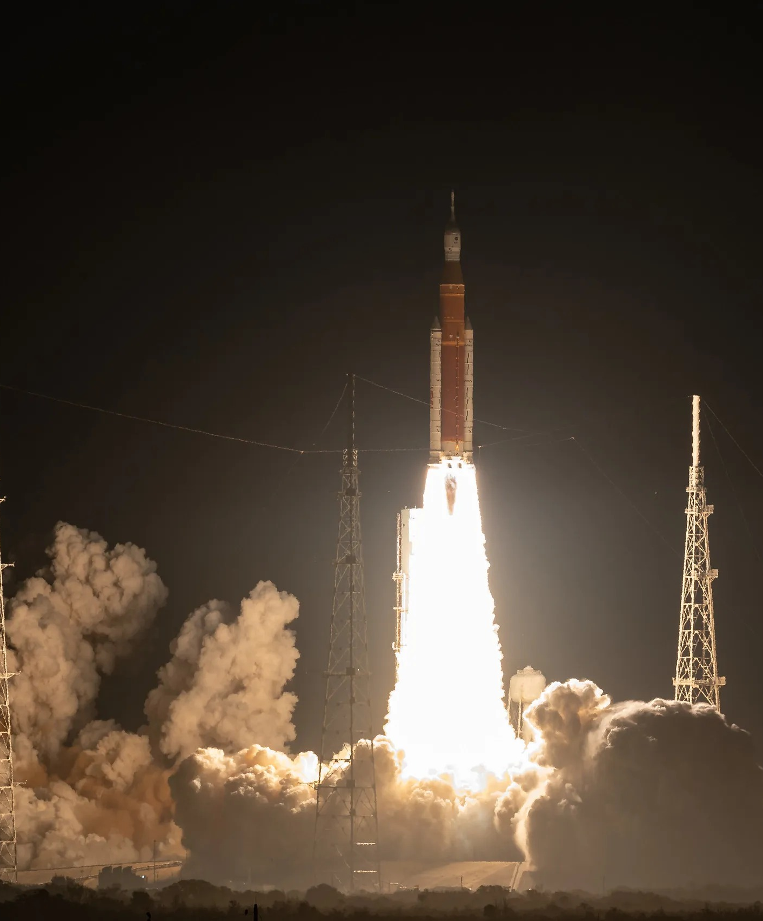
The project goal
Turn a space-mission idea into an interactive simulator.
🚀 Mission statement
Build a web application that uses real formulas to calculate and visualise a simplified journey from Earth to Mars.
Create a clear visual route from Earth to Mars
Show the maths instead of hiding it in code
Let the viewer change mission assumptions
Explain whether the mission is feasible, risky or impossible
Final output
Interactive Mars mission simulator
Design a Mars Mission | 2/10

Slide 3
Why Mars missions need maths
A spacecraft cannot simply fly in a straight line to where Mars is now.
Naive route
Calculated orbital route
Transfer path
Earth
Mars
Sun
Earth and Mars are both moving around the Sun. The mission must calculate the right path, speed and timing so the spacecraft meets Mars later.
Design a Mars Mission | 3/10

Slide 4
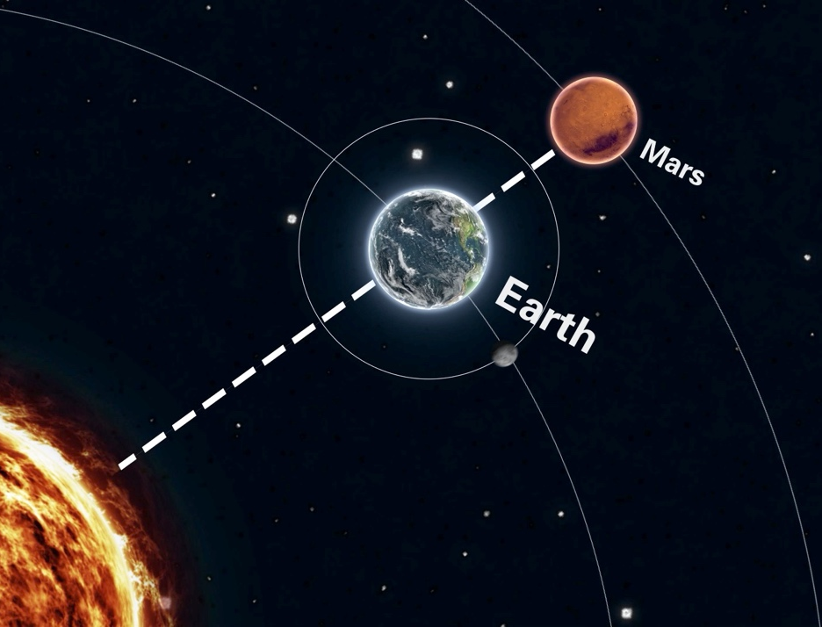
Hohmann transfer orbit
A fuel-efficient way to move between two planetary orbits.
High-level idea
The spacecraft moves onto an elliptical orbit that touches Earth’s orbit at departure and Mars’s orbit at arrival.
Δv Two velocity changes
One burn changes the spacecraft’s orbit near Earth. Another velocity change is needed near Mars.
Efficient, not fastest
A Hohmann transfer saves fuel but usually takes longer than a high-energy transfer.
The simulator uses this path as the main mission route.
Design a Mars Mission | 4/10

Slide 5
The main mathematics
Inputs are converted into transfer time, required delta-v and available delta-v.
Transfer orbit size
Transfer time
Vis-viva velocity
a = (r₁ + r₂) / 2
t = π × √(a³ / μ)
v = √(μ × (2/r − 1/a))
Finds the semi-major axis of the transfer ellipse.
Estimates the time for half of the elliptical orbit.
Calculates speed on the transfer path.
✓ Simulator output
Required delta-v is compared with available delta-v to decide if the mission is feasible, risky or impossible.
Rocket equation
Δv = vₑ × ln(m₀ / mf)
Calculates available delta-v from mass and engine exhaust velocity.
Design a Mars Mission | 5/10

Slide 6
Engineering trade-offs
A Mars mission is not one calculation — it is a balance of choices.
Fuel mass
More fuel increases available delta-v, but the spacecraft also becomes heavier and harder to accelerate.
Engine efficiency
Higher exhaust velocity gives more delta-v from the same fuel, but may involve cost, complexity or lower thrust.
Transfer time
Fuel-efficient paths can take longer, increasing exposure to radiation, isolation and equipment failure.
⚠ Mission risk
A mission may be mathematically possible but still risky if the delta-v safety margin is too small.
Less fuel / lower energy
More margin / more mass
Mission status
Feasible • Risky • Impossible
Design a Mars Mission | 6/10

Slide 7
How the software was built
The app separates inputs, maths, status logic and visualisation.
User inputs
Fuel, dry mass, engine efficiency, orbital assumptions
Calculation layer
Hohmann transfer, vis-viva velocity, rocket equation
Mission state
Shared values update the whole simulator
Visual output
3D scene, maths panel, timeline and status
</> Technology stack
Next.js + React + TypeScript for the app, React Three Fiber / Three.js for space visualisation, and Docker for a consistent demo environment.
↔ Design principle
Keep the equations in a reusable calculation layer so the same results feed the maths panel, mission status and 3D scene.
Design a Mars Mission | 7/10

Slide 8
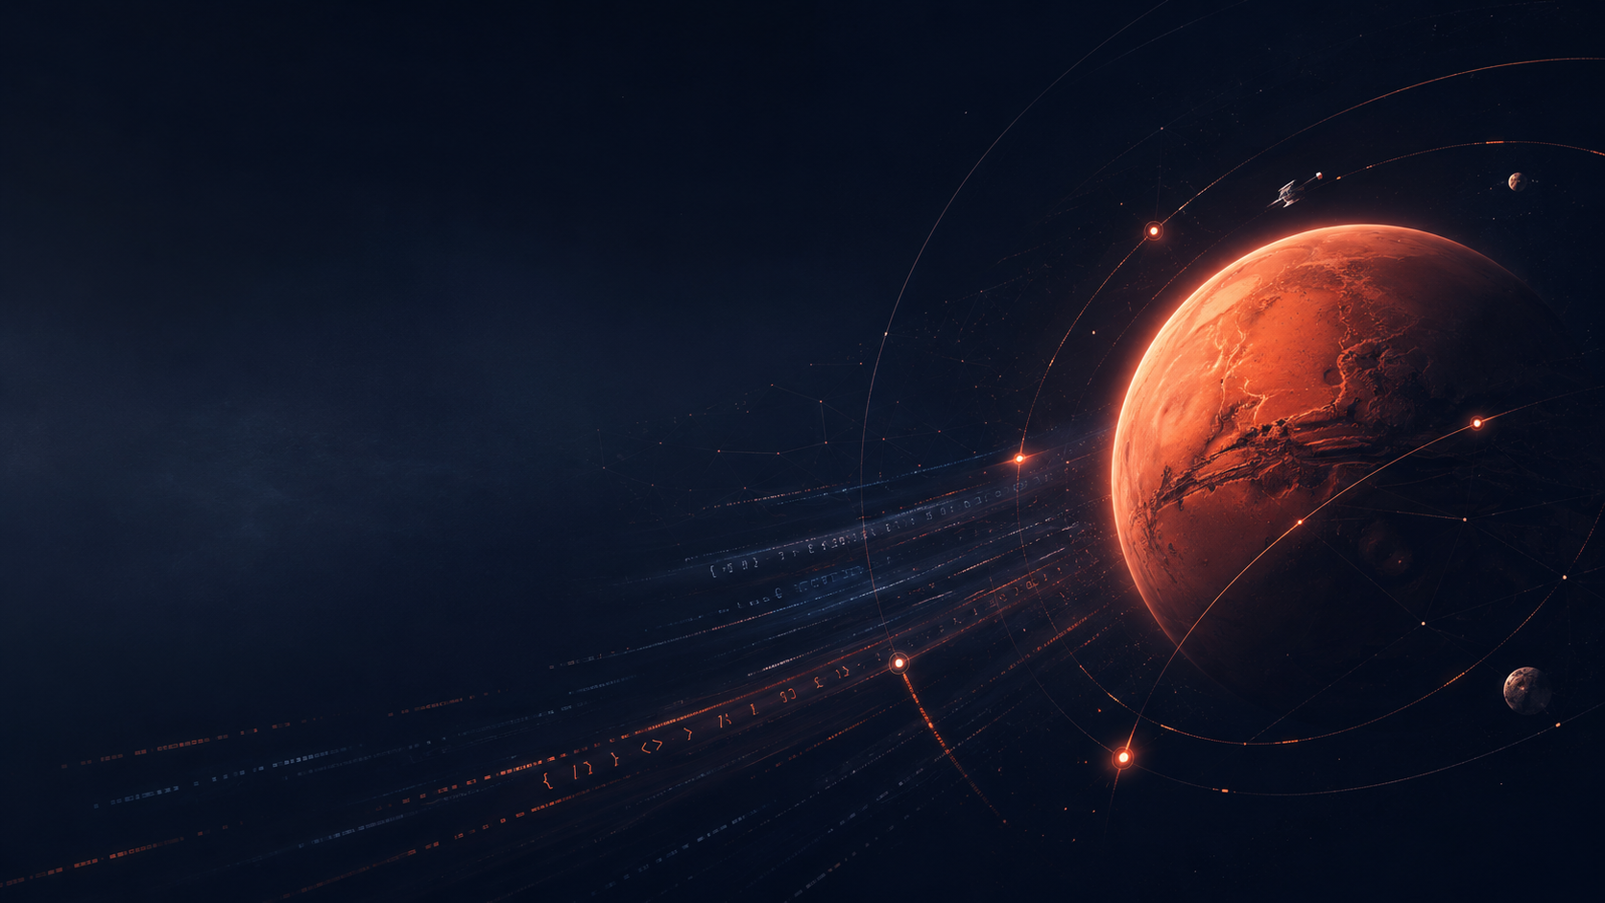
PROJECT METHODOLOGY · AI WEB DEVELOPMENT
From mission idea to working website
A repeated build loop: define the goal, prompt the AI, review the output, test the result, then improve it.
Goal
Prompt
Build
Review
Improve
01
Plan the feature
02
Use AI as a coding partner
03
Verify like an engineer
Each section started with a clear acceptance goal: mission page, maths page, project log, and presentation route.
Claude helped turn short design prompts into components, calculations, copy and page structure.
I checked the maths, tested the live simulator, and made sure the explanation stayed understandable.
Key idea
AI speeds up development, but the student still directs the project: deciding what matters, checking accuracy, and improving the user experience.
Design a Mars Mission · Methodology · 1/4

Slide 9
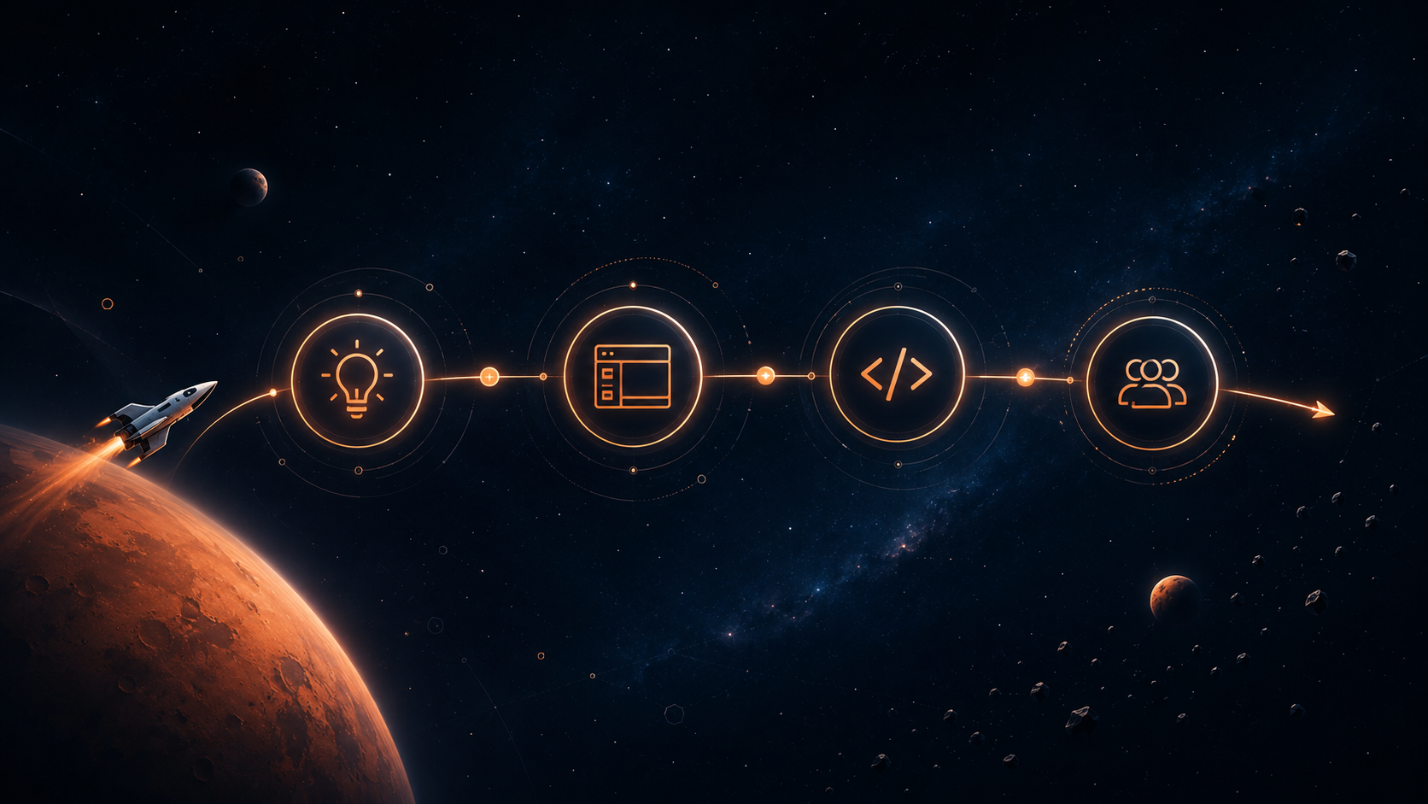
TOOLCHAIN · HOW THE WORK WAS ORGANISED
Tools matched to each stage
Process discipline
Work was broken into small deliverables so every AI-generated change had a clear purpose and could be checked against the website.
The project used different tools for ideas, tasks, coding, terminal work and version control.
Claude
research, explanations, code prompts
Claude Design
page layout, visual direction, UI ideas
Linear
milestones, checkpoints, acceptance criteria
Ghostty
terminal commands, local build and testing
Fork
Git history, commits, review before changes
Design a Mars Mission · Methodology · 2/4

Slide 10
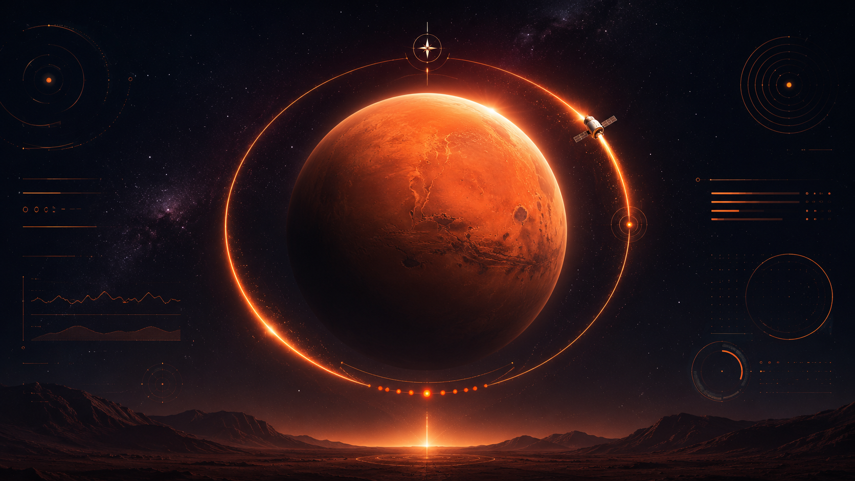
ACHIEVEMENTS · MILESTONES REACHED
What the project produced
The website moved from a project idea into an interactive showcase with maths, engineering and software evidence.
✓
Website foundation
✓
Mission simulator
✓
Maths made visible
Responsive landing page, navigation, mission brief and project goals.
Interactive 3D scene with Sun, Earth, Mars, orbit rings, spacecraft motion and telemetry.
Hohmann transfer formulas, substituted values, constants and adjustable inputs.
✓
Engineering judgement
✓
Project evidence
✓
Final showcase
Rocket equation explorer compares required and available delta-v and rates feasibility.
Checkpoint notes, learning log and photos of handwritten research notes.
Presentation page links the website, demo script and final checklist together.
Design a Mars Mission · Methodology · 3/4

Slide 11
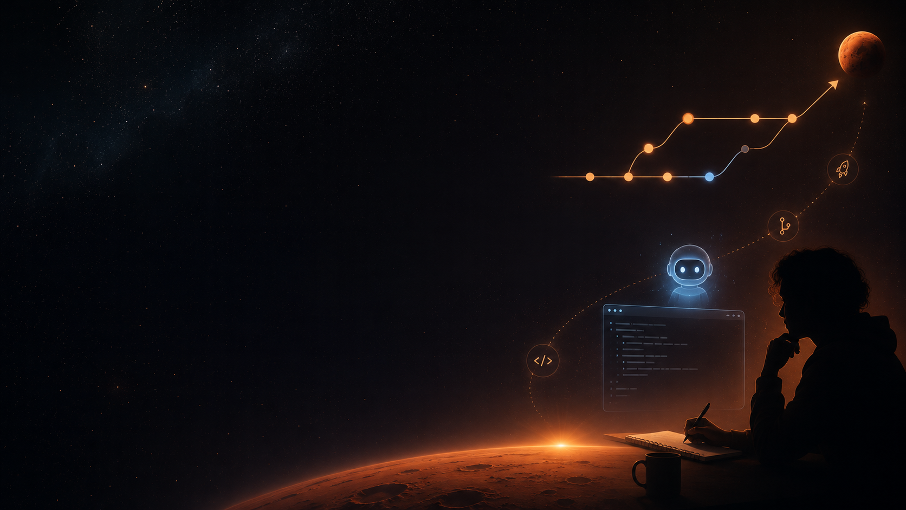
MY PROCESS
How I worked
1
How did I decide what to build first?
2
Where did AI help most?
3
What did I have to check myself?
4
What would I improve next?
“AI did not replace the thinking. It helped me move faster, but I still had to plan, test, understand and explain the result.”
Talking point
Design a Mars Mission · Methodology · 4/4

Slide 12
What I learned
The project combined space science, engineering thinking and software development.
Orbital mechanics
I learned how a Hohmann transfer can be calculated and turned into a visual route.
Engineering judgement
I learned that a mission can be possible on paper but still risky if the safety margin is too small.
Software design
I learned to connect inputs, calculations and visual components so the simulator updates live.
Explaining complexity
I learned to translate formulas into plain English so a reviewer can understand the result quickly.
AI-assisted workflow
AI helped with research, UI ideas, component scaffolding and documentation, outputs still had to be checked and understood.
Project delivery
I learned to break the work into checkpoints: mission scene, maths panel, engineering layer and final presentation.
Design a Mars Mission | 9/10

Slide 13
Future improvements and conclusion
Next steps would make the simulator more realistic and useful.
Real launch-window calculations and live planetary positions
Faster transfer options and burn-duration modelling
Radiation, crew safety and life-support estimates
Save and compare different mission designs
★ Conclusion
This project showed how mathematics, engineering and software can work together to turn a space mission concept into an interactive simulation.
Questions?
Design a Mars Mission
Image sources: NASA / public web assets. Replace screenshot placeholders with final app captures before presenting.
Design a Mars Mission | 10/10

